Slide 1

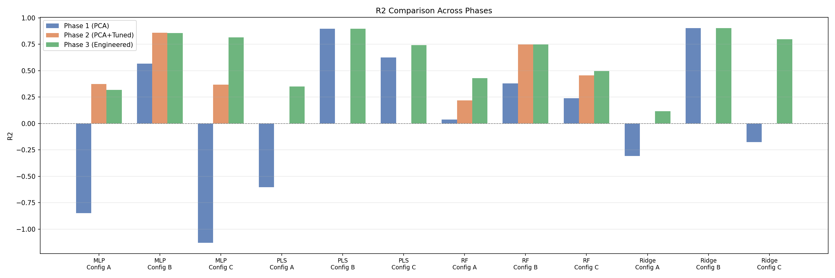
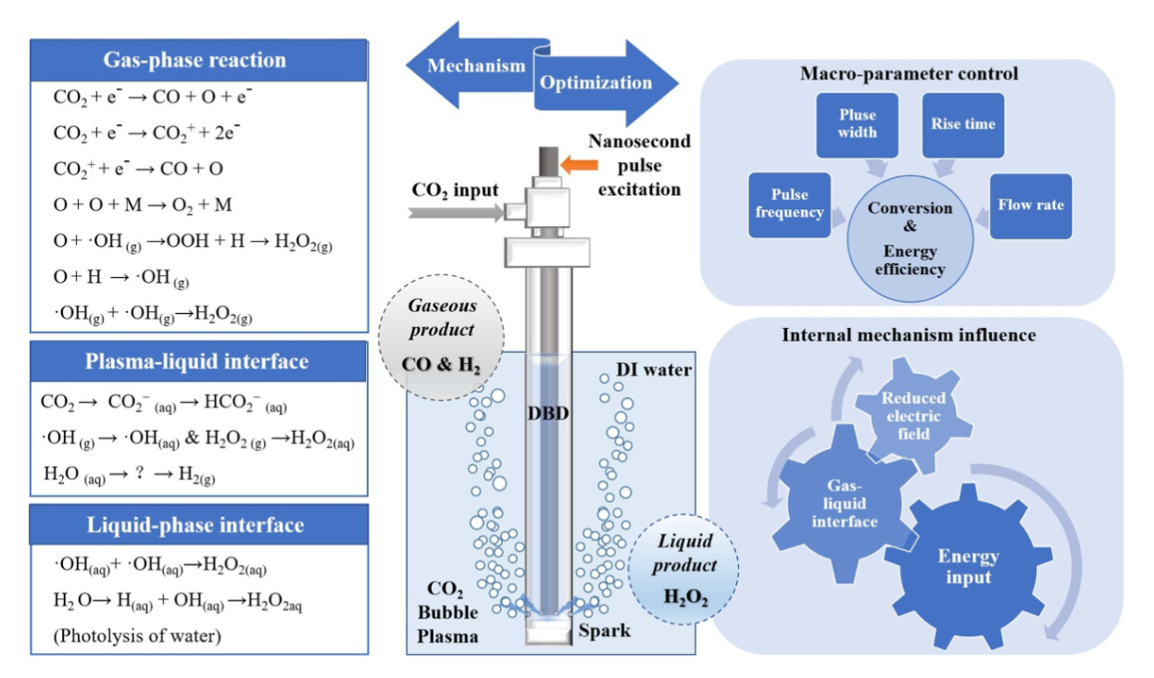
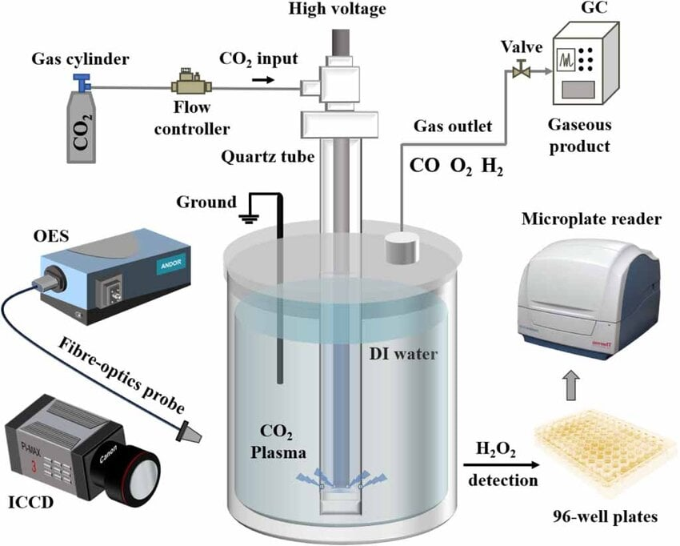
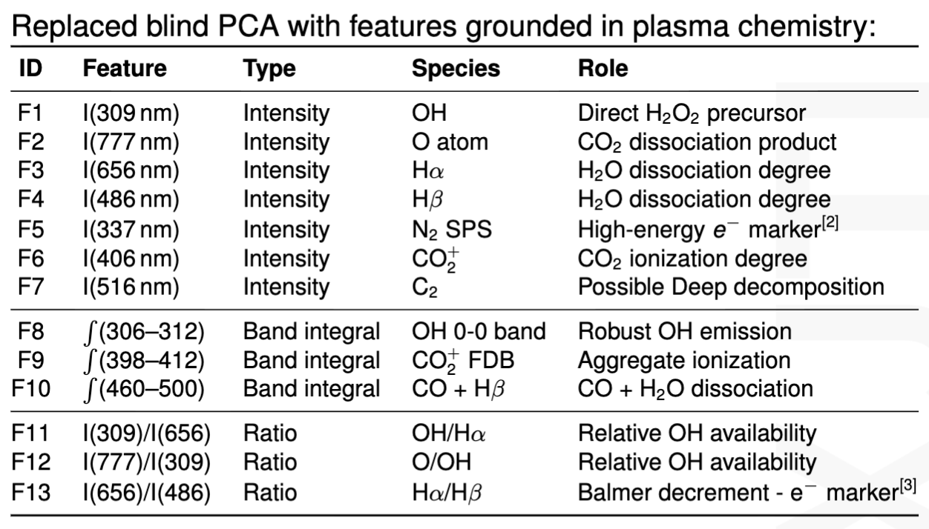
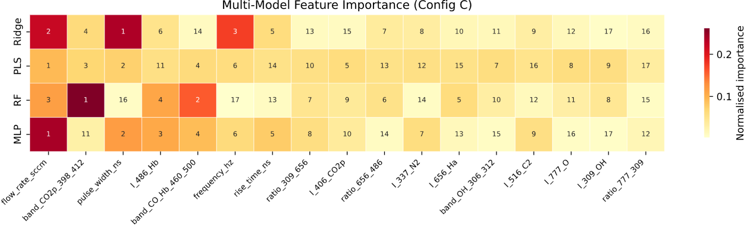
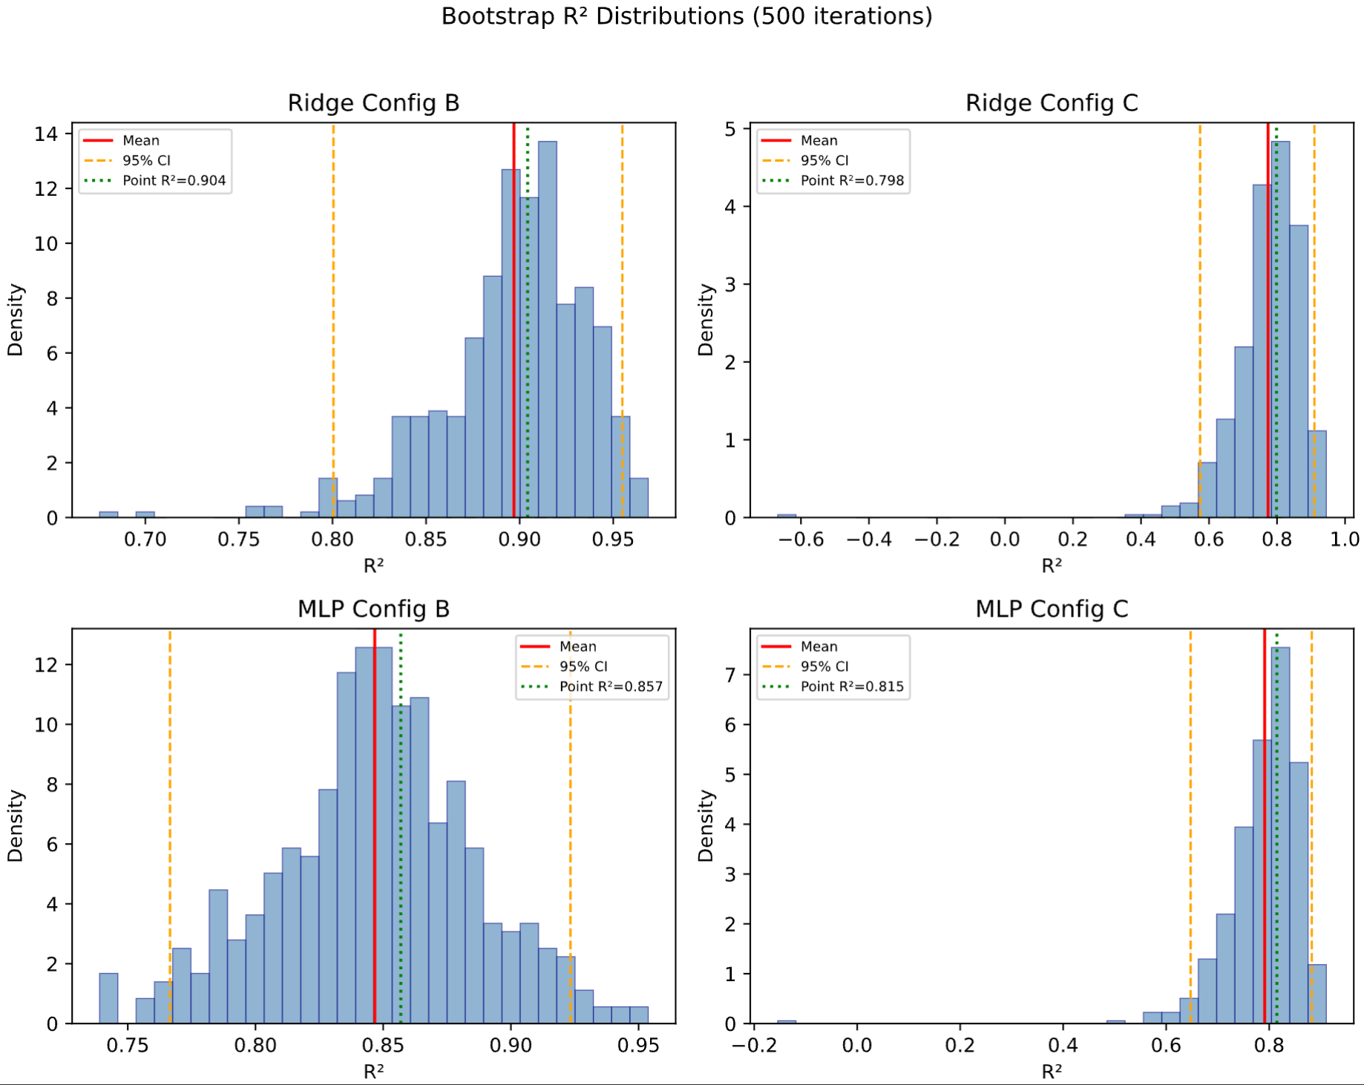
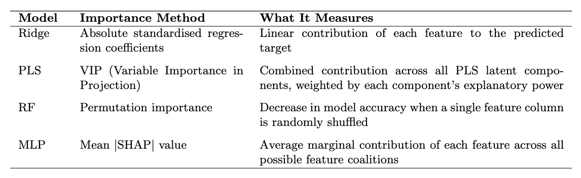
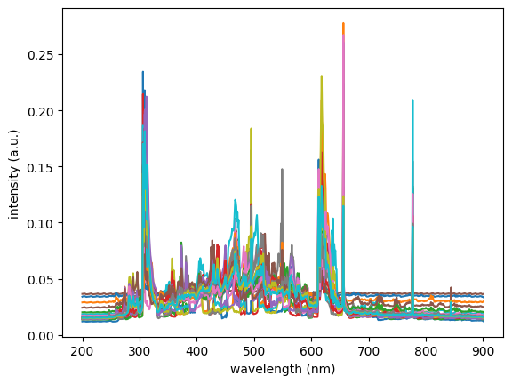
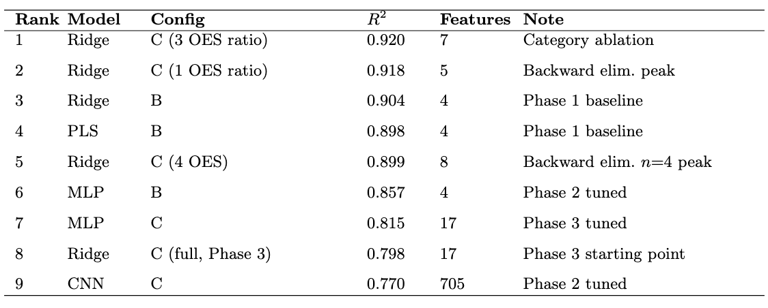
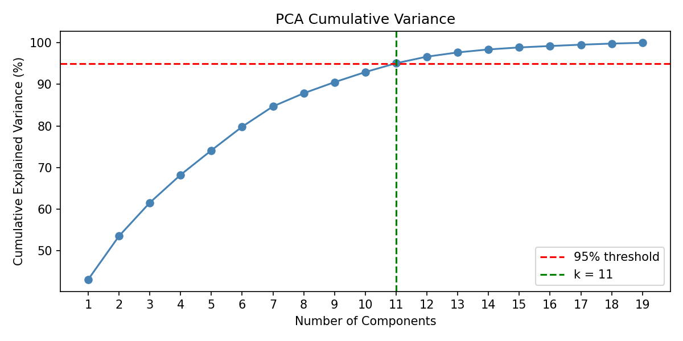

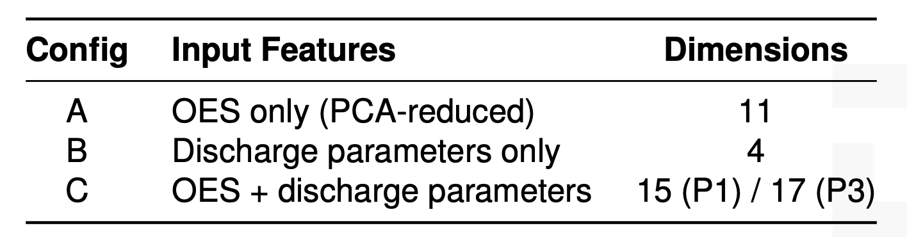
Machine Learning Assisted Real-Time Plasma Diagnosis:
Domain-Knowledge-Driven Feature Engineering Enable H₂O₂ Yield Prediction
Supervisor: Xin Tu Assessor: Xue Yong
Mingjie Zhu (201850714)
Introduction
RF, MLP and CNN are tuned with over 100 trails per model-config pair.
Phase 3: Manually construction input features based on plasma chemistry domain-knowledge.
Construct physically meaningful features based on plamsa chemistry domain knowledge, instead of PCA-selected OES components.
Update three training input configs with new features.
Phase 4: Interpretability analysis and feature reduction via multi-model consensus and backward elimination
Evaluate feature importance for each model via different methods.
Statistically evaluate R² confidence interval of Ridge and PLS using bootstrap resampling.
Analyze model’s essential learning outcome using permutation test.
Remove low representative features via eliminating one-by-one (backward elimination) or category-by-category (category ablation), to find the best performed model and config.
Phase 4 discovers that CO₂ flow rate and its OES band integral are two most important factor that affect H₂O₂ yield. Meanwhile, bootstrap confidence interval analysis shows that there is no statistic difference between Ridge config C and MLP config C.
Permutation test validates that Ridge model successfully captures mapping relationship from X->Y with p<0.00005.
After eliminating features one by one reversely, the best model and input is found to be Ridge with 3 OES ratios + discharge parameter.
Nanosecond pulsed CO2 bubble discharge demonstrates novel pathway that utilizes plasma technology to convert CO2 into useful chemical products, such as H2 and H2O2[1].
Optical Emission Spectroscopy (OES) is a cost-effective instrument that enables non-intrusive, real-time measurement into the status of plasma.
In this research, OES spectrum, combined with reaction discharge parameters, are engineered to build informative features that allow Machine Learning models (i.e. linear regression, artificial neural network) to recognize and predict H2O2 yield. Data used in this research is collected from Gao et al.[1]
Figure 3: R² Performance for Each Phase
Figure 1: Nanosecond Pulsed CO₂ Bubble Discharge Setting^{[1]}
Figure 4: Heatmap for Feature Importance
Table 2: Manually Selected OES Features
Table 3: Methods for Evaluating Feature Importance
Figure 5: Bootstrap Confidence Interval Evaluation (Ridge vs MLP)
Figure 2: 20 Optical Emission Spectrum of 701 Samples
Methodology
Results
The project is conducted in 4 iterative phases, each building on the previous one to enhance model performance and interpretability.
Phase 1: Baseline modeling with PCA-reduced OES features + discharge parameters.
Principle Component Analysis is a dimensionality reduction technique that utilizes covariance matrix and solves its eigenvector as PCs.
Both linear and non-linear models are tested: Ridge, PLS, SVR, XGBoost, RF, MLP, CNN.
Three configs of features/parameters are used as input data for models.
Phase 2: Hyperparameter tuning of nonlinear models (RF, MLP, CNN) using Bayesian optimization.
Optuna is a framework for hyperparameter tuning. It use Tree-structured Parzen Estimator to optimize hyperparameter for each model.
Principle component analysis on 701 OES frequencies requires 11 components to reach 95% cumulative variance, and first 5 PCs capture ~74% of variance.
However, in phase 1, discharge parameter-only configurations dominate for most models, and OES-only inputs performs poorly.
After tuning parameters in phase 2, R² for all models are improved universally. MLP shows the most significant recovery from -1.13 to 0.33 for Config C and reaches 0.86 for Config B. CNN with config C remains the best OES-utilizing model.
The most pivotal breakthrough is in phase 3. Feature engineering dramatically improved Config C for MLP model from 0.33 to 0.80 and Ridge model from -0.17 to 0.80.
Table 4: Best Performed Models and Configs across Phases
Conclusion
This study demonstrates that domain-knowledge-driven feature engineering is the decisive factor in enabling accurate machine learning prediction of H₂O₂ yield from nanosecond pulsed CO₂ bubble plasma.
Replacing PCA with physically meaningful OES features dramatically improved model performance (Ridge Config C R² from −0.17 to 0.80).
Interpretability analysis identified CO₂ flow rate and its OES band integral as the most influential predictors. Permutation testing confirmed genuine predictive power (p < 0.00005), and a parsimonious Ridge model with just 3 OES ratios and discharge parameters matched complex neural networks, demonstrating that interpretable linear models suffice when features are well-engineered.
Figure 3: Principle Components Analysis Variance Curve
Table 1: Configuration of Data Input Construction
[1] Y. Gao, R. Zhou, L. Hong, B. Chen, J. Sun, R. Zhou, and Z. Liu, "Efficient synthesis of CO and H₂O₂ via nanosecond pulsed CO₂ bubble discharge," J. Phys. D: Appl. Phys., vol. 57, no. 37, Sep. 2024, doi: 10.1088/1361-6463/ad5569.
[2] P. Paris, M. Aints, F. Valk, T. Plank, A. Haljaste, K. V. Kozlov, and H.-E. Wagner, "Intensity ratio of spectral bands of nitrogen as a measure of electric field strength in plasmas," J. Phys. D: Appl. Phys., vol. 38, no. 21, pp. 3894–3899, 2005, doi: 10.1088/0022-3727/38/21/010.
[3] H. R. Griem, Principles of Plasma Spectroscopy. Cambridge, U.K.: Cambridge University Press, 1997, ch. 7.

